Slide 1
COT5615: Math for Intelligent Systems I
Anand Rangarajan
Lecture 4

Slide 2
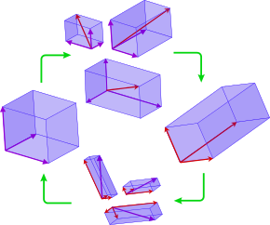
Introduction: Basis of a vector space
Multiple bases
Need not be mutually perpendicular
Have to be the same number

Slide 3
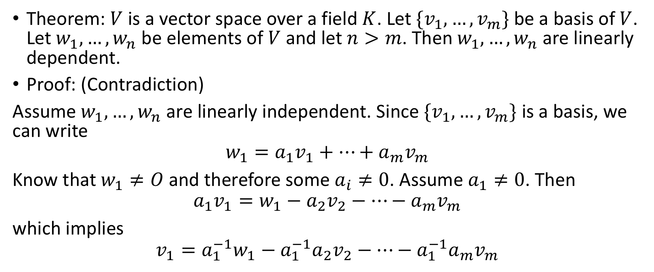
Dimension of a vector space
Theorem: $V$ is a vector space over a field $K$. Let $\{v_{1},…,v_{m}\}$ be a basis of $V$. Let $w_{1},…,w_{n}$ be elements of $V$ and let $n>m$. Then $w_{1},…,w_{n}$ are linearly dependent.
Proof: (Contradiction)
Assume $w_{1},…,w_{n}$ are linearly independent. Since $\{v_{1},…,v_{m}\}$ is a basis, we can write
$$w_{1}=a_{1}v_{1}+…+a_{m}v_{m}$$
Know that $w_{1}≠O$ and therefore some $a_{i}≠0$. Assume $a_{1}≠0$. Then
$$a_{1}v_{1}=w_{1}−a_{2}v_{2}−…−a_{m}v_{m}$$
which implies
$$v_{1}=a_{1}^{−1}w_{1}−a_{1}^{−1}a_{2}v_{2}−…−a_{1}^{−1}a_{m}v_{m}$$

Slide 4
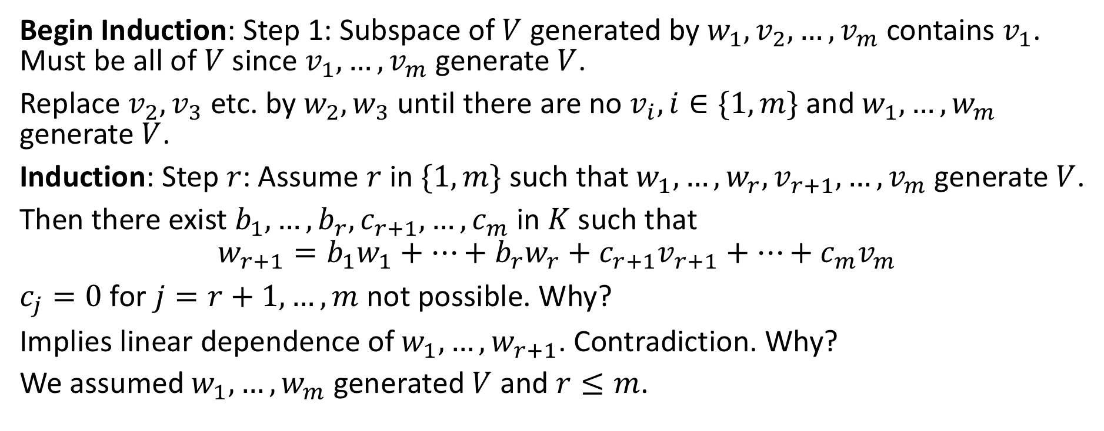
Proof of 3.1 (contd.)
Begin Induction: Step 1: Subspace of $V$ generated by $w_{1}, v_{2},…, v_{m}$ contains $v_{1}$. Must be all of $V$ since $v_{1},…,v_{m}$ generate $V$.
Replace $v_{2},v_{3}$ etc. by $w_{2},w_{3}$ until there are no $v_{i},i∈\{1,m\}$ and $w_{1},…,w_{m}$ generate $V$.
Induction: Step $r$: Assume $r$ in $\{1,m\}$ such that $w_{1},…,w_{r},v_{r+1},…,v_{m}$ generate $V$.
Then there exist $b_{1},…,b_{r},c_{r+1},…,c_{m}$ in $K$ such that
$$w_{r+1}=b_{1}w_{1}+…+b_{r}w_{r}+c_{r+1}v_{r+1}+…+c_{m}v_{m}$$
$c_{j}=0$ for $j=r+1,…,m$ not possible. Why?
Implies linear dependence of $w_{1},…,w_{r+1}$. Contradiction. Why?
We assumed $w_{1},…,w_{m}$ generated $V$ and $r≤m$.

Slide 5
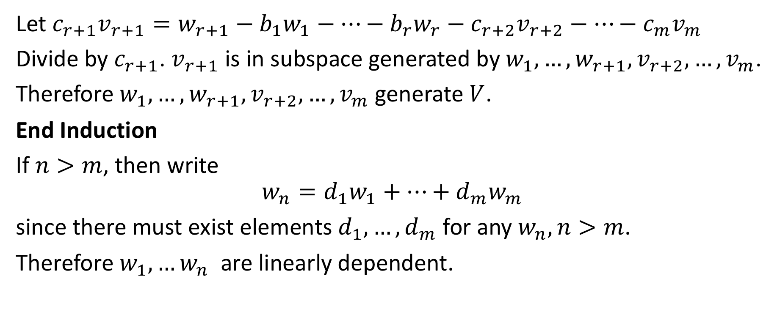
Proof of 3.1 (contd.)
Let $c_{r+1}v_{r+1}=w_{r+1}−b_{1}w_{1}−…−b_{r}w_{r}−c_{r+2}v_{r+2}−…−c_{m}v_{m}$
Divide by $c_{r+1}$. $v_{r+1}$ is in subspace generated by $w_{1},…,w_{r+1},v_{r+2},…,v_{m}$.
Therefore $w_{1},…,w_{r+1},v_{r+2},…,v_{m}$ generate $V$.
End Induction
If $n>m$, then write
$$w_{n}=d_{1}w_{1}+…+d_{m}w_{m}$$
since there must exist elements $d_{1},…,d_{m}$ for any $w_{n},n>m$.
Therefore $w_{1},…w_{n}$ are linearly dependent.

Slide 6
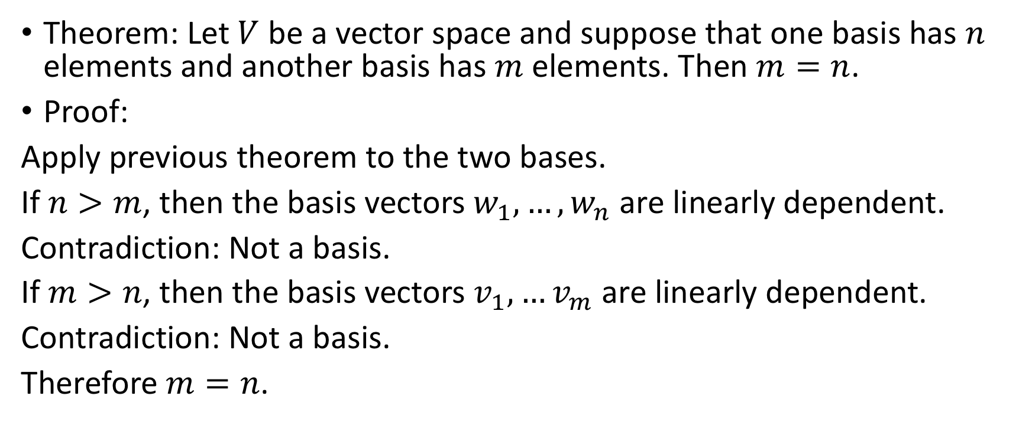
Two Bases
Theorem: Let $V$ be a vector space and suppose that one basis has $n$ elements and another basis has $m$ elements. Then $m=n$.
Proof:
Apply previous theorem to the two bases.
If $n>m$, then the basis vectors $w_{1},…,w_{n}$ are linearly dependent.
Contradiction: Not a basis.
If $m>n$, then the basis vectors $v_{1},…v_{m}$ are linearly dependent.
Contradiction: Not a basis.
Therefore $m=n$.

Slide 7
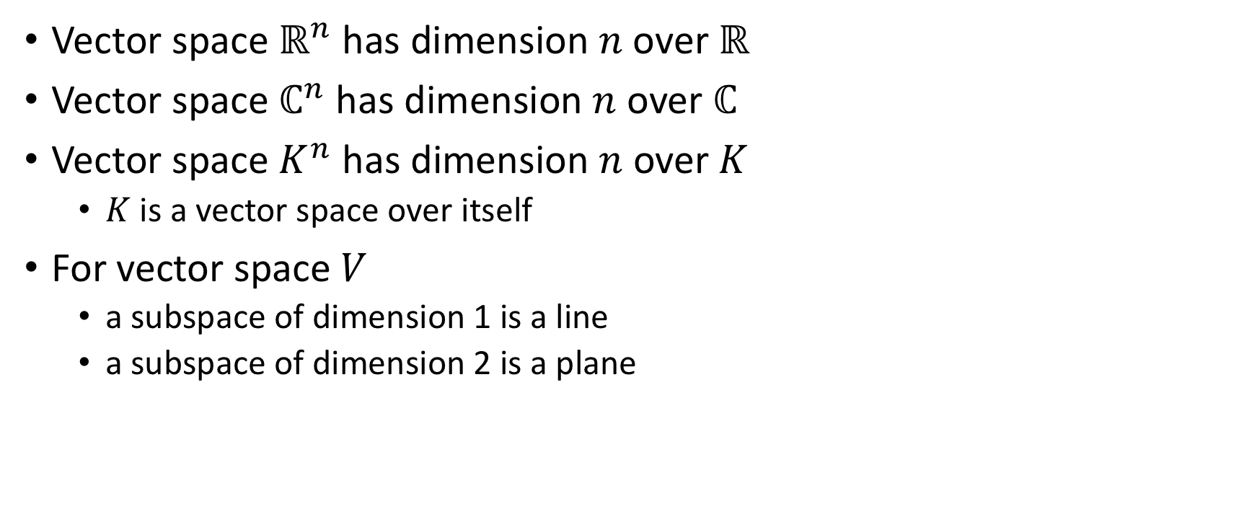
Examples (Watch video for this)
Vector space $ℝ^{n}$ has dimension $n$ over $ℝ$
Vector space $ℂ^{n}$ has dimension $n$ over $ℂ$
Vector space $K^{n}$ has dimension $n$ over $K$
$K$ is a vector space over itself
For vector space $V$
a subspace of dimension 1 is a line
a subspace of dimension 2 is a plane

Slide 8
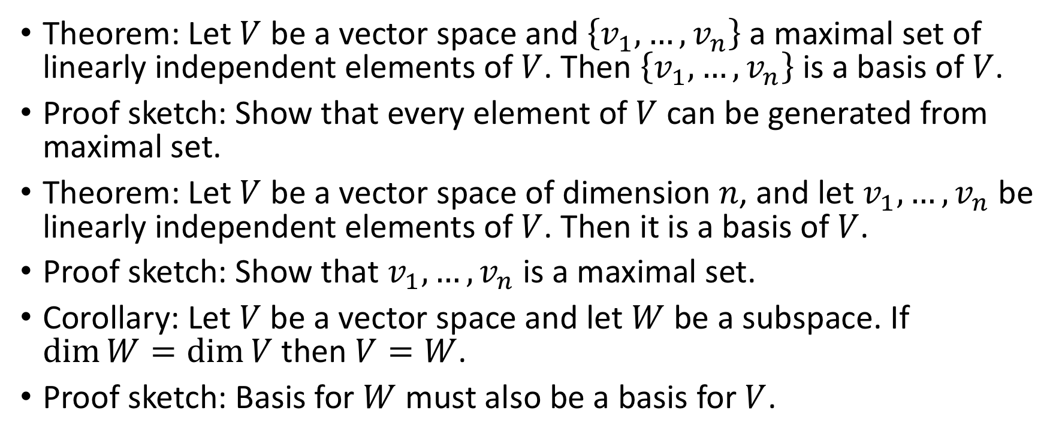
Definition of basis
Theorem: Let $V$ be a vector space and $\left\{v_{1},…,v_{n}\right\}$ a maximal set of linearly independent elements of $V$. Then $\left\{v_{1},…,v_{n}\right\}$ is a basis of $V$.
Proof sketch: Show that every element of $V$ can be generated from maximal set.
Theorem: Let $V$ be a vector space of dimension $n$, and let $v_{1},…,v_{n}$ be linearly independent elements of $V$. Then it is a basis of $V$.
Proof sketch: Show that $v_{1},…,v_{n}$ is a maximal set.
Corollary: Let $V$ be a vector space and let $W$ be a subspace. If $\dim{W=\dim{V}}$ then $V=W$.
Proof sketch: Basis for $W$ must also be a basis for $V$.

Slide 9
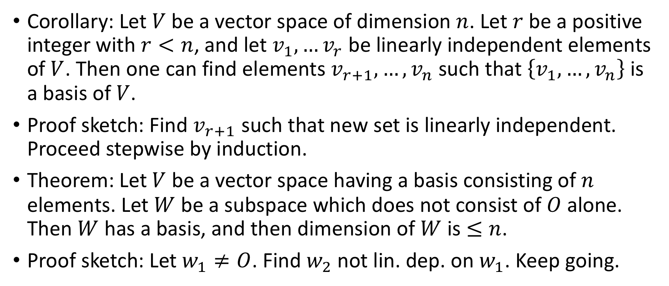
Definition of basis (contd.)
Corollary: Let $V$ be a vector space of dimension $n$. Let $r$ be a positive integer with $r<n$, and let $v_{1},…v_{r}$ be linearly independent elements of $V$. Then one can find elements $v_{r+1},…,v_{n}$ such that $\left\{v_{1},…,v_{n}\right\}$ is a basis of $V$.
Proof sketch: Find $v_{r+1}$ such that new set is linearly independent. Proceed stepwise by induction.
Theorem: Let $V$ be a vector space having a basis consisting of $n$ elements. Let $W$ be a subspace which does not consist of $O$ alone. Then $W$ has a basis, and then dimension of $W$ is $≤n$.
Proof sketch: Let $w_{1}≠O$. Find $w_{2}$ not lin. dep. on $w_{1}$. Keep going.

Slide 10
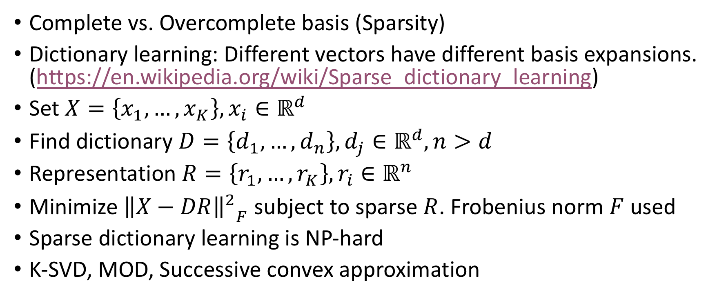
Relevance to machine learning
Complete vs. Overcomplete basis (Sparsity)
Dictionary learning: Different vectors have different basis expansions. (https://en.wikipedia.org/wiki/Sparse_dictionary_learning)
Set $X=\left\{x_{1},…,x_{K}\right\}, x_{i}∈ℝ^{d}$
Find dictionary $D=\left\{d_{1},…,d_{n}\right\}, d_{j}∈ℝ^{d}, n>d$
Representation $R=\left\{r_{1},…,r_{K}\right\}, r_{i}∈ℝ^{n}$
Minimize ${{\left\|X−DR\right\|}^{2}}_{F}$ subject to sparse $R$. Frobenius norm $F$used
Sparse dictionary learning is NP-hard
K-SVD, MOD, Successive convex approximation

Slide 11
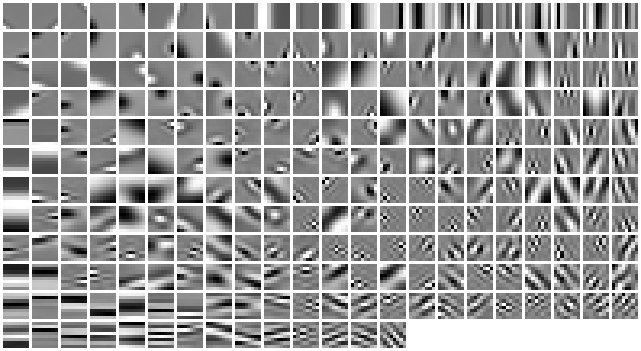
Example

